Slide 1
Command and Mediator pattern
Command pattern
Mediator pattern
Quiz
2018.10.17

Slide 2
1. Command pattern – Real World Examples
Turn on/off the light.
Order dishes in restaurant.
Stock buy/sell system.

Slide 3
1. Command pattern – Definition
The command pattern is a behavioral design pattern in which an object is used to encapsulate all information needed to perform an action or trigger an event at a later time. This information includes the method name, the object that owns the method and values for the method parameters.
The command pattern encapsulates a request as an object, thereby letting us parameterize other objects with different requests, queue or log requests, and support undoable operations.

Slide 4
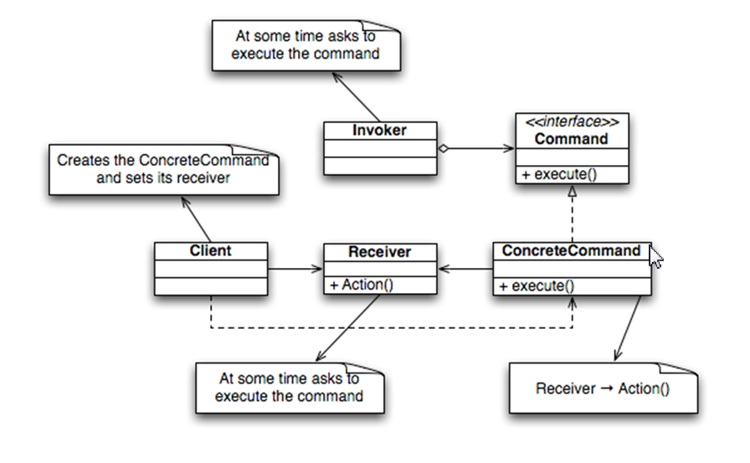
1. Command pattern – Class diagram

Slide 5
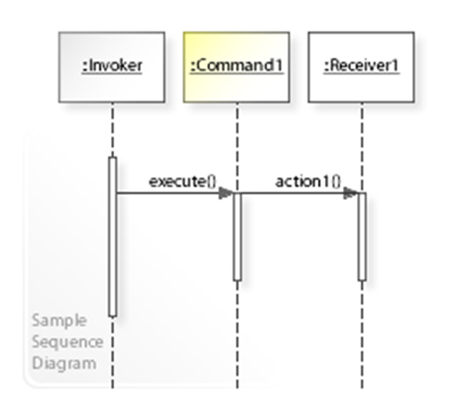
1. Command pattern – Sequence diagram

Slide 6
1. Command pattern – Advantages
Makes our code extensible as we can add new commands without changing existing code.
Reduces coupling the invoker and receiver of a command.

Slide 7
1. Command pattern – Disadvantages
Increase in the number of classes for each individual command.

Slide 8
1. Command pattern – Source code demo

Slide 9
2. Mediator pattern – Definition
The mediator pattern defines an object that encapsulates how a set of objects interact. This pattern is considered to be a behavioral pattern due to the way it can alter the program's running behavior.
The mediator design pattern defines an object that encapsulates how a set of objects interact. The Mediator is a behavioral pattern (like the Observer or the Visitor pattern) because it can change the program’s running behavior.

Slide 10
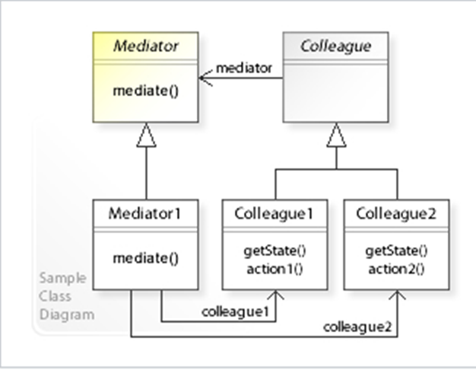
2. Mediator pattern – Class diagram

Slide 11
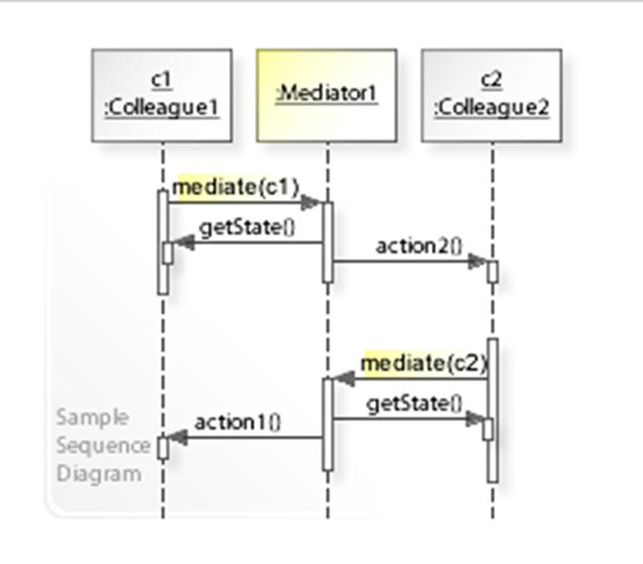
2. Mediator pattern – Sequence diagram

Slide 12
2. Mediator pattern – Advantages
Simplicity.
You can replace one object in the structure with a different one without affecting the classes and the interfaces.

Slide 13
2. Mediator pattern – Disadvantages
The Mediator often needs to be very intimate with all the different classes, And it makes it really complex.

Slide 14
2. State pattern – Source code demo

Slide 15
4. Quiz
What kind of command pattern? a. Creational b. Structural c. Behavioral d. Concurrency
What kind of Mediator pattern? a. Creational b. Behavioral c. Structural d. Concurrency
What are the disadvantages of Command pattern?
a. Increase in the number of classes for each individual command
b. Nothing
c. Memory leaks caused by Lapsed listener problem
d. This pattern avoids duplication of objects which might be huge size and memory intensive.
What is the benefit of Mediator pattern?
a. Simplicity.
b. New states can be added by defining new state classes.
c. One of the advantages of this pattern is security.
d. You can replace one object in the structure with a different one without affecting the classes and the interfaces.
Which are these methods that Command class commonly have in Command pattern?
a. SwitchState, Unsubcrible, Notify b. Execute c. Clone, Update
d. Sucrible, Unsubcrible, Notify
How many class types need to implement in Mediator pattern?
a. 4 b. many c. 2 d. 8

Slide 16
End…
Thank you!

